Slide 1
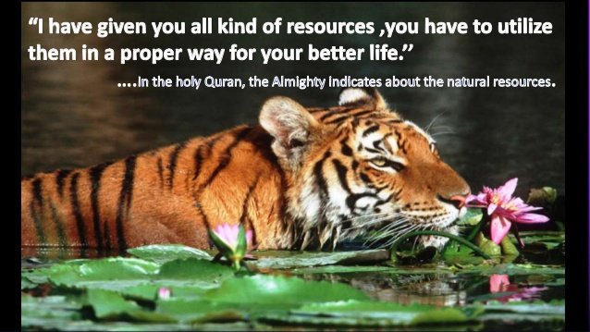
Lecture-5
Mineral resources of Bangladesh

Slide 2
Mineral resources are very valuable from all the natural resources. It is very important for any country’s economic development. Bangladesh is not rich in mineral resources. Coal, iron, mineral oil is the main resource for the development of a country. Those countries are developed which are utilizing their mineral resources properly. As example we can tell about United States of America, United Arab Emirates, Saudi Arabia, Russian Federation, Kuwait etc. Nowadays we are looking that it is going for become industrialized. So, mineral resources are not only important for our country but also too much essential. Now these resources are heavily used in our industrial sector as raw material.

Slide 3
Classification of mineral resources of Bangladesh
Those are listed below-
Power resources:
Immaterial mineral resources.
Material mineral resources.
Power resources: All the mineral resources which are used to produce power for our uses are called power resources. Some of our mineral resources are in this category. Those are
Natural Gas.
Coal.
Carosine Oil.
Petroleum etc
Though we have some other power resources which are not coming from mineral those areas-
Wood fuel.
Electric power.
Tidal power etc.

Slide 4
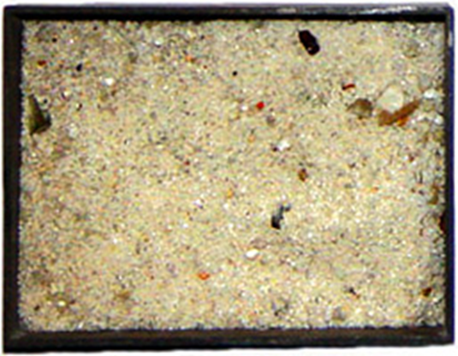
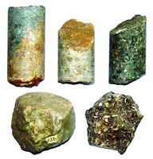
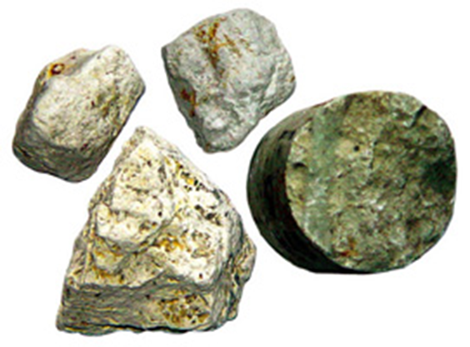
Immaterial mineral resources: All mineral resources which are not material can be categorized in this group. We can have some of this resource. That are-
Lime stone
Glass sand (silica sand)
China clay (White clay)
Hard Rock
Mineral Sand
Salt
Atomic Sand
Sulfur
Glass sand, Comilla
Fossiliferous limestone, Sylhet
White clay, Netrokona

Slide 5
Material mineral resources:
Copper
Iron
Zinc etc.
Though these types of resources are not found in our country but many scientist thinks that we might have these resources under the surface and we may discovered its future period and consume it.

Slide 6
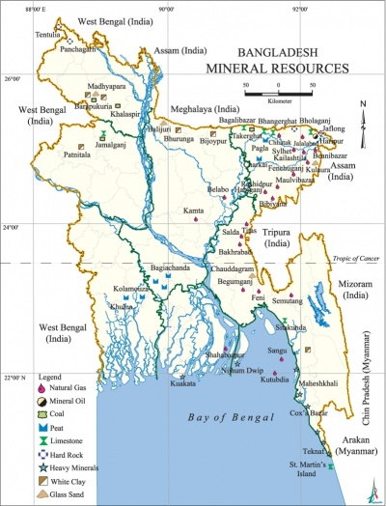
Mineral Resources of Bangladesh

Slide 7
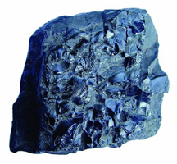
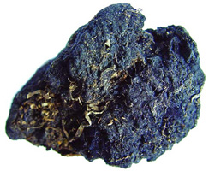
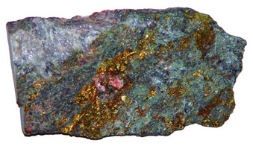
Barapukuria coal, Dinajpur
Peat
Hard Rock, Dinajpur

Slide 8
Description of mineral and power resources of Bangladesh
Natural Gas: Natural Gas is the most important resources for our country. From the very past time our scientist assume that our country have a huge amount of natural gas, but we discovered these gas fields for the first time just after 1950.
Coal: Coal is an important mineral resource for Bangladesh. We have different types of coal. That are-
Bituminous coal (best coal in Bangladesh)
Pit coal
Lignite coal (worst coal in Bangladesh)
Mineral oil:
In 1987 our scientists found an oil field in Sylhet’s Horipur and another one in Bormihal of Moulovibazar. In Haripur we have four core barrel oil reserves.
Limestone: Limestone is popular for the raw materials of cement. Limestones have been discovered in Nineteen Century at Sylhet’s Jaflong and Joyontika.

Slide 9
Silica Sand: Silica sand is the main raw material of glass industry. For these reason it is also called as glass sand. Silica sand is available in many places of Bangladesh.
White clay: Mainly it is used to produce Ceramic products and sanitary products. China clay is important for our ceramic and sanitary industry. Now a days it is also used as row material of electric accessories producing industry and some chemical industry.
Mineral Sand:
An Australian scientist had discovered the mineral sand in the sea shore of Cox’sBazar for the first time. This discovery might be a great opportunity for Bangladesh. This mineral sand is also called as radioactive sand. Scientist found this type of sand in follows place-
Cox’esbazar
Takenaf
Moheskhali
Maturberi
Kutubdia

Slide 10
Salt: Though salt is one kind of mineral resource but for our country it could not be called mineral resource. Main source of salt in our country is sea water that’s why it could not be called mineral resource in our country.
Sulfur: Now we found little quantity of sulfur in our country. In Bangladesh we found it in Kutubdia which is in Cox’s Bazar District.
Wood fuel: It is one kind of power resource in our country. Still today many people of our country use wood fuel for their daily purpose like cooking. Using wood fuel as the source energy is little bit harmful for our nature.
Electric power: Electric power is very important for our country. Most of our industries are being operated by electricity. Bangladesh has total ten centers where electricity has been producing.
Tidal power: Our government should have to take proper care and give proper attention in this sector by using tidal power so that we can produce more electricity.

Slide 11
Uses of mineral resources: Industrial setup
Some uses of our mineral resources for the development of our economy in industrial sector are given bellow-
Raw material and industrial development in Bangladesh: We are using Natural Gas, Silica Sand, white clay as raw material. For these reason Fertilizer, Cement industry are developing in our country. So we can tell mineral resources helping us to make our country industrialized.
Power source: Maximum small and large industries are using heat Electricity and natural gas is main element or key element to produced heat electricity.
Fuel: Natural gas founded in Bangladesh used as fuel for cooking. For this reason most Bangladeshi people gets most economic facilities. On other hand gas also used for produce heat in most fertilized factory.
Natural Gas: Our natural gas and other resources helping us, it makes our import cost of gas and other energy very low. All the mineral resources that we have we need not to import those. By this way they saved a huge amount of foreign currency.

Slide 12
Development of Agriculture: Our mineral resources especially natural gases help us to produce more agricultural product indirectly. Natural gas helps to produce fertilizer and fertilizer helps us to produce more crops.
National income: Mineral resources of a country help to increase the national income of the country.
Higher living standard: Availability of mineral resources makes our national income higher. It helps to create employment opportunities and spread economic activities. As a result per capital income also rises and standard of living of our people being higher People are getting more facilities. For development of our industrial sector and our economy it has great importance. But we are very unlucky that we have lack of sufficient amount of mineral resources. Iron, Manganese, Bauxite etc . mineral is not available in our country and our oil resources are not rich enough. If we have these resources then our country could be more developed.

Slide 13
Solve Unemployment: Mineral and power resources help to spread our economic activities and solve little portion of unemployment problem, It helps us to solve unemployment thus this way—–
Many people all over the country works in different places. People work in gas field Oil field and other places when we find our mineral resource. It creates opportunity for our people to get works and get new job.
For mineral resources many industry are building our country, it also creating many people’s employment opportunity.

